Slide 1
Introduction to Cryptography

Slide 2
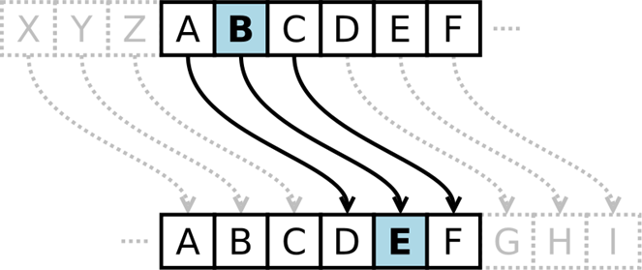
What Is Cryptography
Cryptology
  The art (science) of communication with secret codes.
  Cryptography
    The making of secret codes.
  Cryptanalysis
    The “breaking” of codes.

Slide 3
Concepts and Processes
Alice (sender), Bob (reciever), Eve (eavesdropper)
Plaintext – an original message
Encryption – the process of transforming plaintext into ciphertext
  Ciphertext – an encrypted message
Decryption – the process of transforming ciphertext into plaintext
Encryption key – the text value required to encrypt and decrypt the message or data

Slide 4


Security Requirements
Alice wants to send a message to Bob
  Wants to send it securely
  Wants to make sure an eavesdropper cannot read it (Eve)
Alice
Bob
Encryption
Decryption
Plaintext
Ciphertext
Plaintext
Key
Key
Eve

Slide 5
Clark’s Taxonomy
Communication Systems with Access Control and Identification
  Interception (attacker reads the message);
  Interruption (attacker prevents message delivery);
  Modification (attacker changes a message);
  Impersonation (attacker pretends to be an authorised receiver);
  Fabrication (attacker pretends to be an authorised sender);
  Repudiation (attacker falsely asserts that they did not send or receive a message).
  Subversion (two or more attackers communicate on a stegochannel).

Slide 6
Some Methods of Encryption
Substitution
  Simple
  Monoalphabetic Cipher
  Polyalphabetic Cipher
    Running-key Cipher
Transposition
One-time pads
Many more permeations and variations not shown here
  Hint: go investigate what’s out there

Slide 7
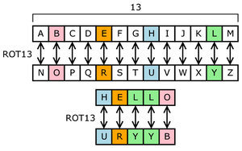
Substitution (Simple)
Plaintext alphabet: ABCDEFGHIJKLMNOPQRSTUVWXYZ
Ciphertext alphabet: NOPQRSTUVWXYZABCDEFGHIJKLM

Slide 8
Monoalphabetic Cipher
One alphabetic character is substituted for another
  Caesar right-three shift
  Or a more random scheme
Subject to frequency analysis attack
A | B | C | D | E | F | G | H | I | J | … | Z
D | E | F | G | H | I | J | K | L | M | … | C
A | B | C | D | E | F | G | H | I | J | … | Z
W | E | R | T | B | N | P | Q | C | U | … | X

Slide 9
Polyalphabetic Cipher
Two or more substitution alphabets
HIGH becomes QNAO
Not subject to frequency attack
Plaintext | A | B | C | D | E | F | G | H | I | … | Z
Alpha 1 | W | E | R | T | B | N | P | Q | C | … | X
Alpha 2 | R | B | I | K | Q | D | X | U | N | … | E
Alpha 3 | V | B | D | R | H | W | A | X | I | … | U
Alpha 4 | M | U | T | X | D | G | P | O | W | … | F
Alpha 5 | Y | D | V | B | J | I | K | E | Z | … | O

Slide 10
Running-key Cipher
Plaintext letters converted to numeric (A=0, B=1, etc.)
Plaintext values “added” to key values giving ciphertext
Modulo arithmetic is used to keep results in range 0-26
  Add 26 if results < 0; subtract 26 if results > 26
Plaintext | A | T | T | A | C | K | A | T | O | N | C | E | V | I | A | N
Key | S | E | C | R | E | T | S | E | C | R | E | T | S | E | C | R
Plaintext | 0 | 19 | 19 | 0 | 2 | 10 | 0 | 19 | 14 | 13 | 2 | 4 | 21 | 8 | 0 | 13
Key | 18 | 4 | 2 | 17 | 4 | 19 | 18 | 4 | 2 | 17 | 4 | 19 | 18 | 4 | 2 | 17
Sum | 18 | 23 | 21 | 17 | 6 | 3 | 18 | 23 | 16 | 4 | 7 | 23 | 11 | 12 | 2 | 4
Ciphertext | S | X | V | R | G | D | S | X | Q | E | H | X | L | M | C | E

Slide 11
Transposition (Columnar)
In a columnar transposition, the message is written out in rows of a fixed length, and then read out again column by column, and the columns are scrambled.
Keyword defines row length and permutation by the alphabetical order of the letters. Null values pad the message.
  Keyword ZEBRAS (632415), message WE ARE DISCOVERED FLEE AT ONCE, and QKJEU.
    6 3 2 4 1 5
    W E A R E D
    I S C O V E
    R E D F L E
    E A T O N C
    E Q K J E U
  The ciphertext = EVLNE ACDTK ESEAQ ROFOJ DEECU WIREE

Slide 12
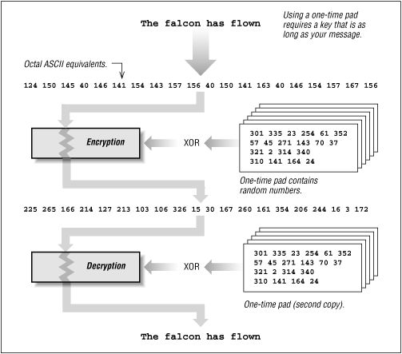
One-time Pad
If the key K is as long as our plaintext message P, when both are written as binary bitstrings, then we can easily compute the bitwise exclusive-or K⊕P.
This encoding is “provably secure”, if we never re-use the key.
Provably secure = The most efficient way to compute P, given K⊕P, is to try all possible keys K. [Stamp, pp. 27-29]
It is often impractical to establish long secret keys.

Slide 13
One-time Pad
Plaintext | A | T | T | A | C | K | A | T | O | N | C | E | V | I | A | N
Key | X | V | G | J | E | R | I | O | Q | W | J | P | E | K | A | F
Plaintext | 0 | 19 | 19 | 0 | 2 | 10 | 0 | 19 | 14 | 13 | 2 | 4 | 21 | 8 | 0 | 13
Key | 23 | 21 | 6 | 9 | 3 | 17 | 8 | 14 | 16 | 22 | 9 | 15 | 4 | 10 | 0 | 5
Sum | 23 | 14 | 25 | 9 | 5 | 1 | 8 | 7 | 4 | 9 | 11 | 19 | 25 | 18 | 0 | 18
Ciphertext | X | O | Z | J | F | B | I | H | E | J | L | T | Z | U | A | U

Slide 14
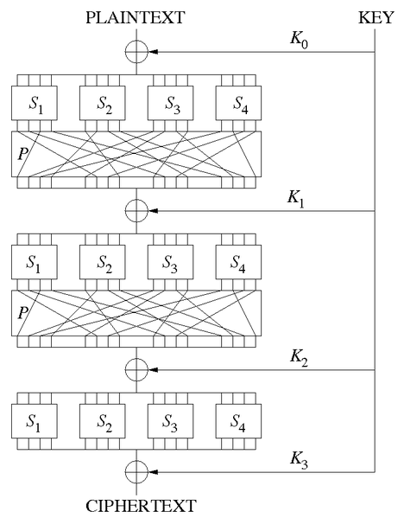
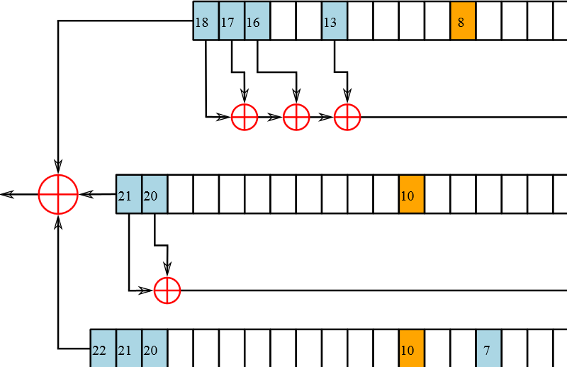
Types of Encryption
Block cipher
Stream cipher

Slide 15
Block Cipher
A block cipher consists of two paired algorithms, one for encryption, E, and the other for decryption, D.
Both algorithms accept two inputs
  an input block of size n bits and a key of size k bits
  both yield an n-bit output block
We can encrypt an arbitrarily long bitstring P by breaking it up into blocks P₀, P₁, P₂, …, of some convenient size (e.g. 256 bits), then encrypting each block separately.
You must vary the encryption at least slightly for each block, otherwise the attacker can easily discover i, j : P_{i} = P_{j}.
  Cipher Block Chaining takes each plaintext block and XOR with the ciphertext from the previous block, before being encrypted. [Stamp, pp. 57, 72-73]
Common block ciphers: DES, 3DES, AES, CAST, Blowfish.

Slide 16
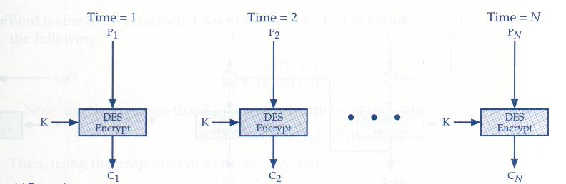
Block Cipher
Electronic Code Book
  Simplest block cipher mode
  Each block encrypted separately
    Like plaintext encrypts to like ciphertext
W. Stallings, Network Security Essentials, Prenitce Hall

Slide 17
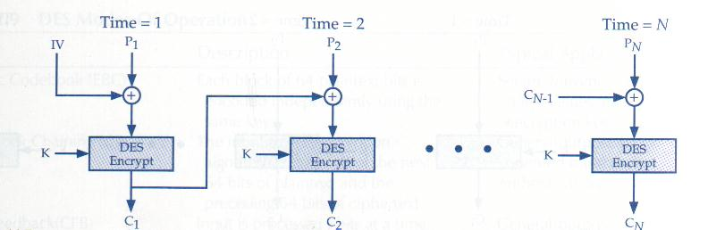
Block Cipher
Cipher-block Chaining (CBC)
  Ciphertext output from each encrypted plaintext block in the encryption used for the next block
    First block encrypted with IV (initialization vector)
W. Stallings, Network Security Essentials, Prenitce Hall

Slide 18
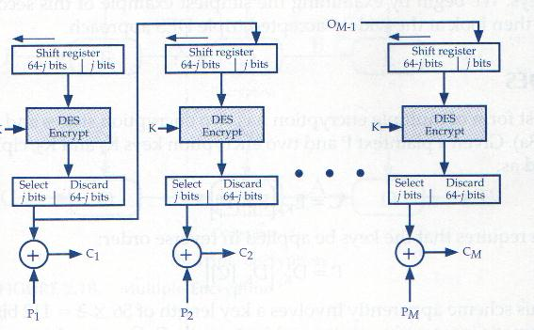
Block Cipher
Output Feedback (OFB)
  Plaintext is XOR’d with the encrypted material in the previous block to produce ciphertext
W. Stallings, Network Security Essentials, Prenitce Hall

Slide 19
Block Cipher
Counter (CTR)
  Uses a “nonce” (a random number that is used once) that is concatenated with a counter or other simple function, which is encrypted by the block cipher, and the output XOR’d with the plaintext block to product the ciphertext block.

Slide 20
Stream Cipher
A stream cipher is a symmetric key cipher where plaintext digits are combined with a pseudorandom cipher digit stream (keystream).
Each plaintext digit is encrypted one at a time with the corresponding digit of the keystream to give a digit of the ciphertext stream.
In practice, a digit is typically a bit and the combining operation is an exclusive-or (XOR).
RC4 used in TLS is a stream cipher

Slide 21
Stream Cipher
Encryption: simple XOR with key
Decryption: simple XOR with the same key
Plaintext | 1 | 1 | 0 | 1 | 0 | 0 | 1 | 1 | 0 | 1 | 0 | 0 | 1 | 1 | 0 | 0
Key | 0 | 1 | 1 | 0 | 1 | 0 | 0 | 1 | 0 | 1 | 1 | 0 | 1 | 0 | 1 | 0
Ciphertext | 1 | 0 | 1 | 1 | 1 | 0 | 1 | 0 | 0 | 0 | 1 | 0 | 0 | 1 | 1 | 0
Ciphertext | 1 | 0 | 1 | 1 | 1 | 0 | 1 | 0 | 0 | 0 | 1 | 0 | 0 | 1 | 1 | 0
Key | 0 | 1 | 1 | 0 | 1 | 0 | 0 | 1 | 0 | 1 | 1 | 0 | 1 | 0 | 1 | 0
Plaintext | 1 | 1 | 0 | 1 | 0 | 0 | 1 | 1 | 0 | 1 | 0 | 0 | 1 | 1 | 0 | 0

Slide 22
Types of Encryption Keys
Symmetric key
  A shared secret that all parties who participate must know
  If the decryption key kd can be computed from the encryption key ke, then the algorithm is called “symmetric”.
Asymmetric key
  Public / private key
  Openly distribute public key to all parties
  If the decryption key kd cannot be computed (in a reasonable amount of time) from the encryption key ke, then the algorithm is called “asymmetric” or “public-key”.
One-time pad
  Used once, is as large as the message to be encrypted
  See previous slide

Slide 23
Asymmetric Ciphers
Text encrypted with a key can not be decrypted using the same key
Text encrypted with one key may be decrypted using only the corresponding key (public private key relationship)
  Knowledge of one key is not a guidance for finding the corresponding key
The practice is to use two keys called “public” and “private”

Slide 24
Asymmetric Ciphers
Key Generation
  Select (both prime): p and q
  Calculate: n = p x q
  Calculate: Ø(n) = (p - 1)(q - 1)
  Select integer e: gcd(Ø(n), e) = 1; 1<e< Ø (n)
  Calculate d: d = e-1 mod Ø(n)
  Public key: KU = {e,n}
  Private key: KR = {d,n}
  p = 7, q = 17
  n = p * q = 7 x 17 = 119
  Ø(n) = (p –1)(q – 1) = 96
  Select e (e is relative prime to Ø(n) = 96 and less than Ø(n) )
    hence e = 5
  Determine d such that de = 1 mod 96 and d < 96
    hence d = 77 as 77 x 5 = 385 = 4 x 96 +1)
  KU = {5,119}, PR = {77,119}
Rivest-Shamir-Aldeman Cipher (RSA)

Slide 25
Using PK for Authentication
We can use our secret key s to encrypt a message which everyone can decrypt using our public key p.
  E(P, s) is a “signed message”. Simpler notation: [P]_{Clark}
  Only people who know the secret key named “Clark” can create this signature.
  Anyone who knows the public key for “Clark” can validate this signature.
  This defends against impersonation and repudiation attacks.
A “public key infrastructure” (PKI) will help us discover other people’s public keys (p₁, p₂, …), if we know the names of these keys and where they were registered.
  A registry database is called a “certificate authority” (CA).
    Warning: someone might register a key under your name!

Slide 26
Message Digests and Hashing
Message digest – the result of a cryptographic operation on a file or message
  Fixed-length result regardless of message size
  Impossible to derive original message from digest
  No other message should produce the same digest
  Algorithms
    MD-5, SHA-1, HMAC

Slide 27
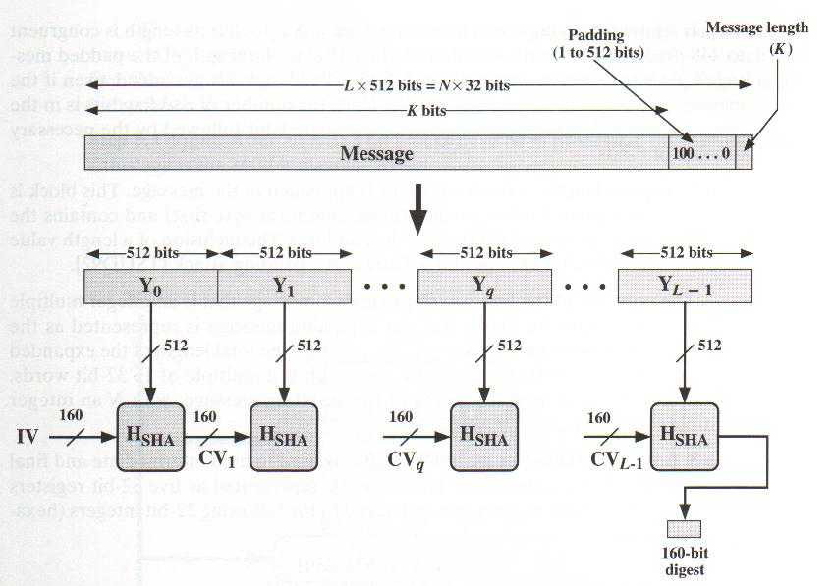
Message Digest algorithm
SHA-1
  produces 160-bit message output out of arbitrary length input
W. Stallings, Network Security Essentials, Prenitce Hall

Slide 28
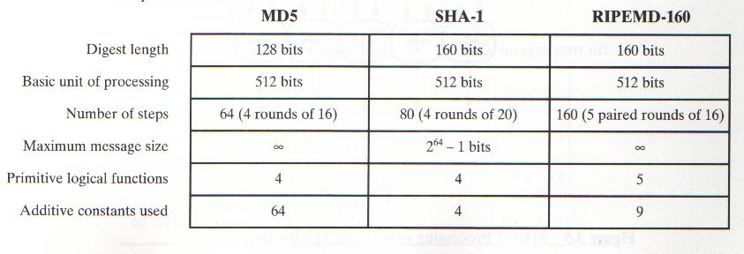
Hash Functions
Keyed hashes (HMACs) are another approach.
  Using private/public/secret keys in generating the hash
    Many variances out there in the literature
W. Stallings, Network Security Essentials, Prenitce Hall

Slide 29
Digital Signature
Message digest that is cryptographically combined with signer’s private key
Requires public key cryptography
Verifies message integrity
Verifies identity of signer
Algorithms: DSA, El Gamal, Elliptic Curve DSA
General principle
  Take the data
  Generate the hash
  Encrypt hash with your private key
  Add that to the data

Slide 30
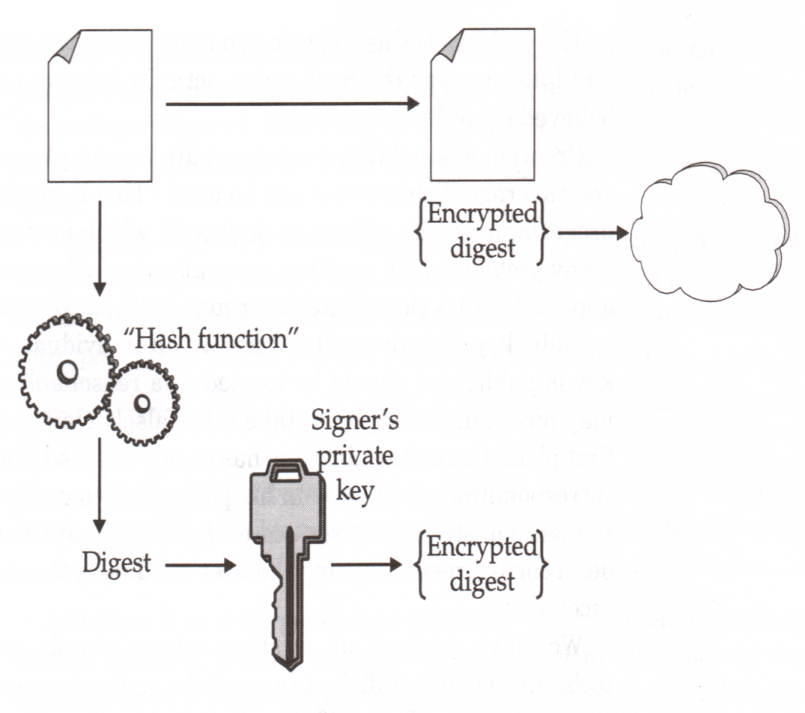
Digital Signature Creation
General principle
  Take the data
  Generate the hash
  Encrypt hash with your private key
  Add that to the data
A. Nash, PKI Implementing and Managing E-Security

Slide 31
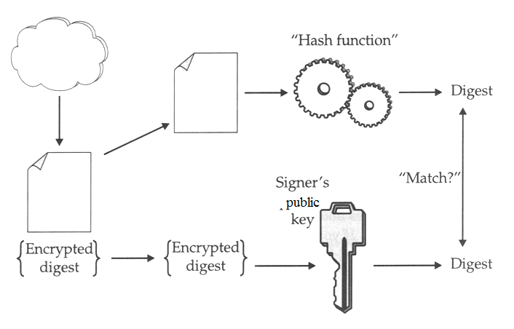
Digital Signature Verification
A. Nash, PKI Implementing and Managing E-Security

Slide 32
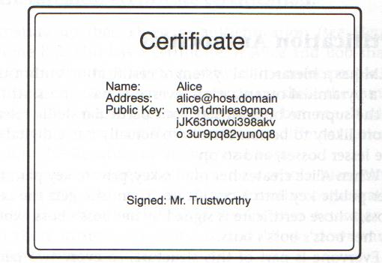
Digital Certificate

Slide 33
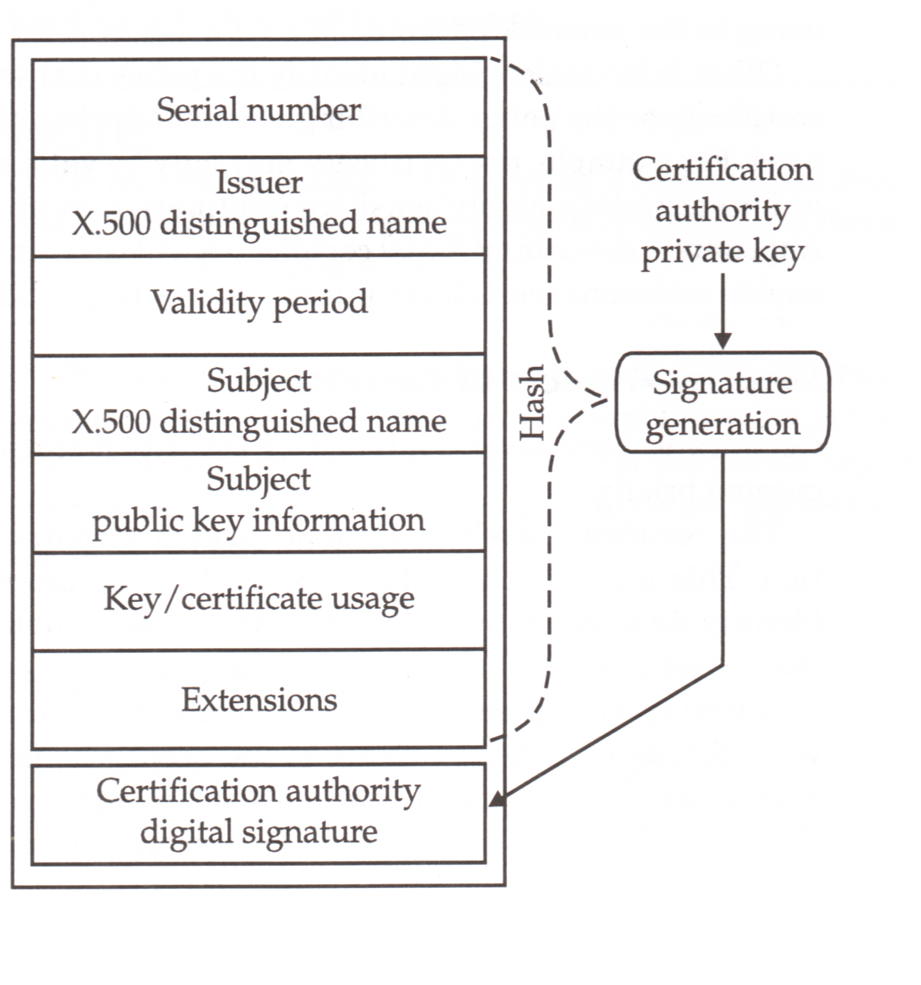
Digital Certificate X.509
A. Nash, PKI Implementing and Managing E-Security

Slide 34
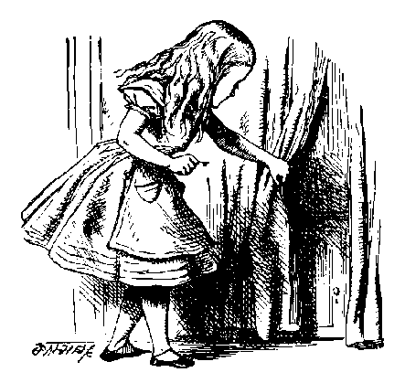
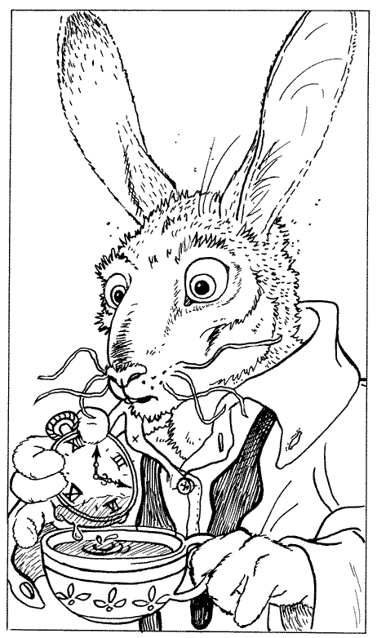
Simple Cryptographic Protocol
R_{A}
[B, “Bob”]_{CA}
{SK}_{B}, {P}_{SK}
Alice
Bob
Alice sends a service request R_{A} to Bob.
Bob replies with his digital certificate.
  Bob’s certificate contains Bob’s public key B and Bob’s name.
  This certificate was signed by a Certificate Authority, using a public key CA which Alice already knows.
Alice creates a symmetric key SK. This is a “session key”.
  Alice sends SK to Bob, encrypted with public key B.
  Alice and Bob will use SK to encrypt their plaintext messages.

Slide 35


Protocol Analysis
R_{A}
R_{A}
[T, “Trudy”]_{CA}
[B, “Bob”]_{CA}
{SK}_{T}, {P}_{SK}
{SK}_{B}, {P}_{SK}
Alice
Trudy: acting as Alice to Bob,
and as Bob to Alice
Bob
How can Alice detect that Trudy is “in the middle”?
What does your web-browser do, when it receives a digital certificate that says “Trudy” instead of “Bob”?
Trudy’s certificate might be [T, “Bob”]CA’
If you follow a URL to “https://www.bankofamerica.org”, your browser might form an SSL connection with a Nigerian website which spoofs the website of a legitimate bank!
Have you ever inspected an SSL certificate?

Slide 36
Attacks on Cryptographic Protocols
A ciphertext may be broken by…
  Discovering the “restricted” algorithm (if the algorithm doesn’t require a key).
  Discovering the key by non-cryptographic means (bribery, theft, ‘just asking’).
  Discovering the key by “brute-force search” (through all possible keys).
  Discovering the key by cryptanalysis based on other information, such as known pairs of (plaintext, ciphertext).
The weakest point in the system may not be its cryptography!
  See Ferguson & Schneier, Practical Cryptography, 2003.
  For example: you should consider what identification was required, when a CA accepted a key, before you accept any public key from that CA as a “proof of identity”.

Slide 37
Limitations and Usage of PKI
If a Certificate Authority is offline, or if you can’t be bothered to wait for a response, you will use the public keys stored in your local computer.
  Warning: a public key may be revoked at any time, e.g. if someone reports their key was stolen.
Key Continuity Management is an alternative to PKI.
  The first time someone presents a key, you decide whether or not to accept it.
  When someone presents a key that you have previously accepted, it’s probably ok.
  If someone presents a changed key, you should think carefully before accepting!
  This idea was introduced in SSH, in 1996. It was named, and identified as a general design principle, by Peter Gutmann (http://www.cs.auckland.ac.nz/~pgut001/).
  Reference: Simson Garfinkel, in http://www.simson.net/thesis/pki3.pdf

Slide 38
Identification and Authentication
You can authenticate your identity to a local machine by
  what you have (e.g. a smart card),
  what you know (e.g. a password),
  what you “are” (e.g. your thumbprint or handwriting)
After you have authenticated yourself locally, then you can use cryptographic protocols to…
  … authenticate your outgoing messages (if others know your public key);
  … verify the integrity of your incoming messages (if you know your correspondents’ public keys);
  … send confidential messages to other people (if you know their public keys).
  Warning: you (and others) must trust the operations of your local machine! We’ll return to this subject…

Slide 39
Questions?

