Slide 1
Evolution of Social-Attribute networks: Measurements, Modeling and implications using Google+
Written by:
Neil Zhengiang Gong, Wenchang Xu, Ling Huang, Prateek Mittal, Emil Stefanov, Vyas Sekar
Proceedings of the IMC 2012 on Internet Measurement and analysis, November 14-16(2012), Boston, Massachusetts, USA
Reviewed by Anup K Choudary

Slide 2
Summary
Evolution of social network structure with user attributes
Novel phenomena carried out on Google+ social network
Development of a Measurement-driven generative model for SANs
Quick Questions:
How many of you have accounts with Google +?
How many of you have noticed the sybil attack in Google+?

Slide 3
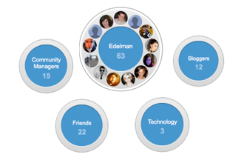
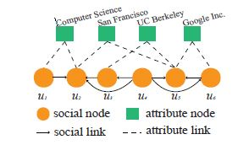
SAN
User Attributes – Static and Dynamic

Slide 4
Experiment
Four types of attributes
Three Phases
Initial phase (day 1 to 20)
Invite only (day 21 to 75)
Public phase (day 76 to 98)
Notes:
Existing models cannot explain the underlying growing mechanism of Google+, and we need to design new models for reproducing social networks similar to Google+.

Slide 5
Generative Model of SAN
Two New Components –
Attribute augmented preferential attachment
Combined linear effect on social degree and attributes.
Attribute-augmented triangle-closing
Baseline
Random-Random (RR)
RR-SAN
Applications such as Link prediction and friend recommendation

Slide 6
Applications
Network extrapolation and sampling
Network visualization and compression
Network Anonymization

Slide 7
Appreciation
The Model accurately reproduces real social-attribute networks
Focus was on Social Attribute Network structure, rather than the conventional way of Social network Structure

Slide 8
Criticism
The Described model focusses only on Static attribute and not on dynamic attribute
Relationship to Heterogeneous networks
Guided ‘greedy’ search in Google+ comparing to the ‘adaptable’ search in Facebook

Slide 9
Question
Can SAN actually be a-Sybil attack ?

