Slide 1
Quick summary of accessibility
Screen readers work by getting the html or other rendering information
The basics are
Clean html or app forms
Well structured – i.e. use <h1> <h2> etc
Alt Tag visual elements such as images
Meaningful labels
Good tab order

Slide 2
What is inaccessible?
Flash – in principle you can make it accessible, but in reality this is super difficult
“Read more…..” links are meaningless
Untagged graphics
Using (untagged) graphics for navigation

Slide 3
HCI Design Patterns and Standards
You have ethical and legal responsibilities!

Slide 4
Agenda
Patterns
Predefined guides as to how to do things
Standards
Rules about how to do things

Slide 5
Learning outcomes
Explain how and why patterns are used in UI design
Describe the contents of a typical pattern
Describe what standards you are likely to have to comply with

Slide 6
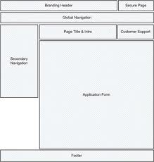
Design Patterns
First proposed by Christopher Alexander for architecture.
Adopted by other disciplines as ways to describe common problems and solutions
Software patterns
HCI patterns

Slide 7
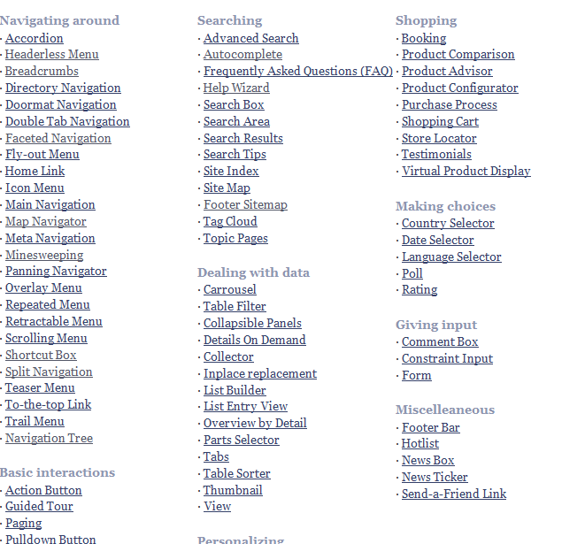
Libraries of patterns Welie
http://www.welie.com/patterns/index.php

Slide 8
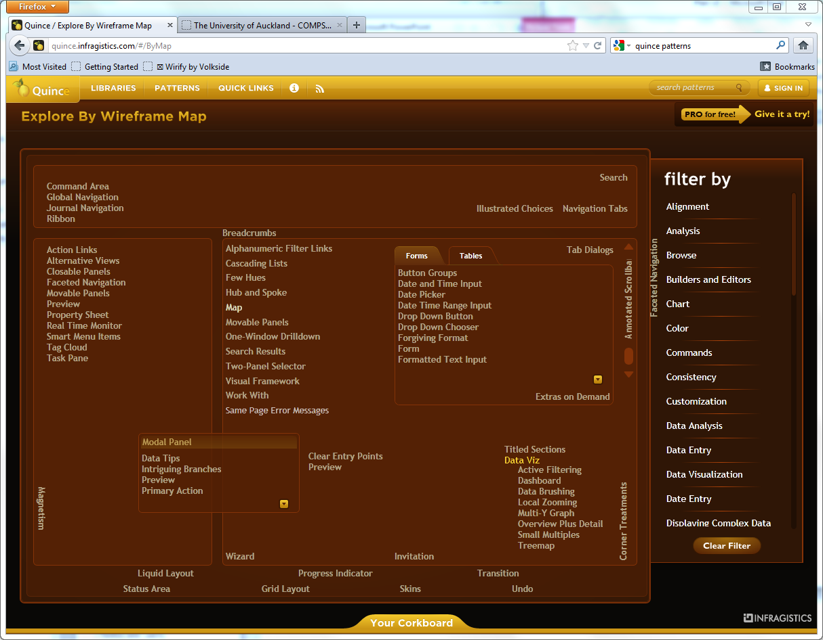
Quince
Seriously good pattern library
Patterns indexed by
Wireframe →
Tag (semantic map)
Alphabetical
http://quince.infragistics.com/

Slide 9
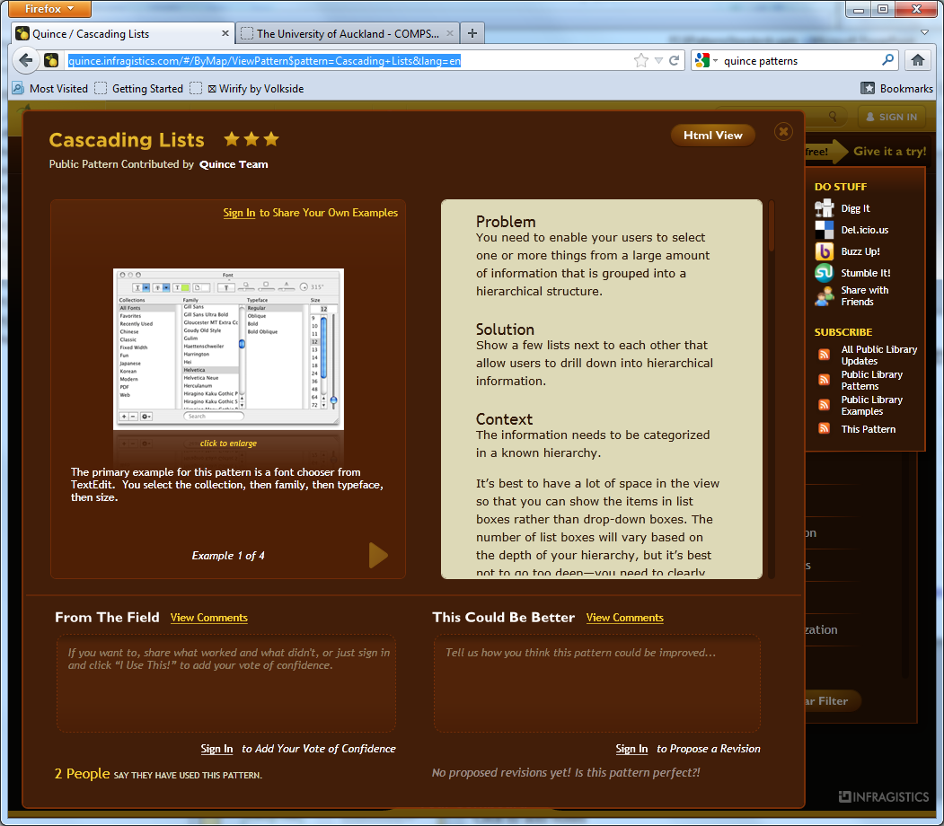
Each pattern
Problem
Solution
Context
Rationale
Implementation
http://www.welie.com/patterns/showPattern.php?patternID=map-navigator
http://quince.infragistics.com/#/ByMap/ViewPattern$pattern=Date+Picker&lang=en

Slide 10
Patterns
Provide a solution or solutions
May or may not be tested
Give you design ideas
Defining patterns for a large system or website will lead to
Consistency
Therefore better usability

Slide 11
Standards
Many organizations (particularly government) require software to be standards compliant!
Standards bodies
W3C world wide web consortium
ISO standards
Governments
UK
USA
New Zealand
Operating Systems

Slide 12
W3C
http://www.w3.org/standards/
Free!
Technical
Comprehensive
Detailed
Well respected

Slide 13
WCAG 2 at a Glance
http://www.w3.org/WAI/WCAG20/glance/
Perceivable
Provide text alternatives for non-text content.
Provide captions and other alternatives for multimedia.
Create content that can be presented in different ways, including by assistive technologies, without losing meaning.
Make it easier for users to see and hear content.
Operable
Make all functionality available from a keyboard.
Give users enough time to read and use content.
Do not use content that causes seizures.
Help users navigate and find content.
Understandable
Make text readable and understandable.
Make content appear and operate in predictable ways.
Help users avoid and correct mistakes.
Robust
Maximize compatibility with current and future user tools.

Slide 14
ISO
Not free
ISO/TR 16982:2002 Ergonomics of human-system interaction—Usability methods supporting human-centered design
High level, for UX designer, systems analysts etc
ISO 9241 Ergonomics of Human System Interaction.
Includes detailed recommendations from hardware to people

Slide 15
Government
Mostly concerned with accessibility
Disability Discrimination Act UK
Section 508 of the Rehabilitation Act (USA)
http://webstandards.govt.nz/

Slide 16
Government
Legislation together with pressure groups have had some remarkable successes
Windows 7 has ‘windows navigator’ built in
iPad/Phone/Pod have touch accessibility for visually impaired
This is really impressive!

Slide 17
Operating Systems
Microsoft
http://msdn.microsoft.com/en-us/library/aa511258.aspx
Apple
http://developer.apple.com/library/mac/#documentation/UserExperience/Conceptual/AppleHIGuidelines/XHIGHIDesign/XHIGHIDesign.html%23//apple_ref/doc/uid/TP30000353-TP6
Android
http://developer.android.com/guide/practices/ui_guidelines/index.html

Slide 18
Advantages
Using patterns and guidelines
Not reinventing the wheel
Future-proof your designs
Makes entry to markets easier

Slide 19
Summary
Explain how and why patterns are used in UI design
To provide design ideas and solutions
Standardize across a system/site
Avoid common errors
Describe the contents of a typical pattern
Problem
Solution
Context
Rationale
Implementation
Standards may be imposed by software purchasers usually
W3C or similar
Government standards

