Slide 1
COMPSCI 345 SOFTENG 350 Human-Computer Interaction (HCI)
Associate Professor Beryl Plimmer Professor Jim Warren

Slide 2
Today’s learning objectives
Meet the lecturers
Be able to define HCI
Be able to articulate the importance of HCI to the success of modern software
Be aware of the course structure and organisation
Appreciate the role of the assessable components in your learning of HCI

Slide 3
What is HCI?
“Human-computer interaction is a discipline concerned with the design, evaluation and implementation of interactive computing systems for human use and with the study of major phenomena surrounding them.” (ACM SIGCHI)
Main elements of HCI are:
People
Computers
Interaction
Activities
Environment
[Video games aside…] People don’t use computers because they want to use computers – they do so to perform some task or activity, to achieve a particular goal.

Slide 4
Motivation
>50% of code in a software project deals with the interface
Major determinant of success of a system
Business view
Get the most out of your users
Marketplace view
There is a choice of systems
Expectation of ease-of-use
System view
Complex interface between computers and humans
Human factors view
Limitations to what humans can do (morale, time, money, life)
Social view
A medium to connect us

Slide 5
USS Vincennes and Aegis (1988)
© Wikimedia Commons
Cool computers… bad outcome….

Slide 6
USS Vincennes and Aegis (1988)
“The Pentagon issues a statement that the Vincennes has downed an Iranian F-14 fighter. The Navy dismisses Iranian reports that an unarmed civilian jetliner has been shot down. Minutes later, the Navy issues a correction; they have indeed shot down, by mistake, Iran Air 655. 290 people were aboard. There were no survivors” (Lee, 1992, p. 233)
In his final report on the incident, Fogarty concluded that Aegis had provided accurate information. The crew had somehow misinterpreted the data. … The operators had fallen victim to the one major flaw of the Aegis … “seemingly trivial design decision.”
“The radar image of the Airbus on one of the giant computer screens displayed the airplane’s position and heading. But critical information about the plane’s altitude was omitted, and instead displayed on different consoles. Correlating the two pieces of information proved difficult at best.”
Recommended human engineering so that Commanding Officer can separate crucial information from other data, and vital data is displayed so they don’t have to shift attention back and forth between displays (Lee, 1992, pp. 234-5)

Slide 7
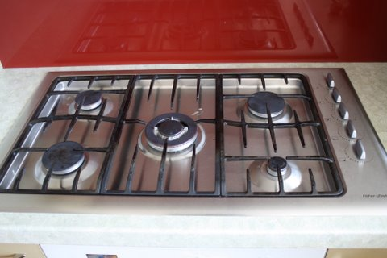
Everyday Interface Issues

Slide 8
HCI: yesterday -> today
Historically
HCI wasn’t a key issue when there were only a few computers in back rooms
Personal computers (e.g. Apple IIe from 1976, IBM PC from 1981, interfaces based on Xerox Star [Mac, Windows]) brought HCI to the common workplace and home
And then there’s the Internet -> Web -> widespread Social Media trajectory
Take banking
Used computers from Day 1, but over recent decades have transformed their interface to customers with ATMs and now online (Web) banking
Cell phones
Most people in the world have access to a cell phone (there’ll all computers, and increasingly ‘smart’)

Slide 9
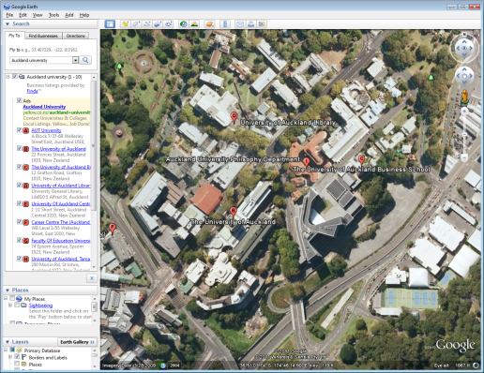
Applications of HCI
Google Earth

Slide 10
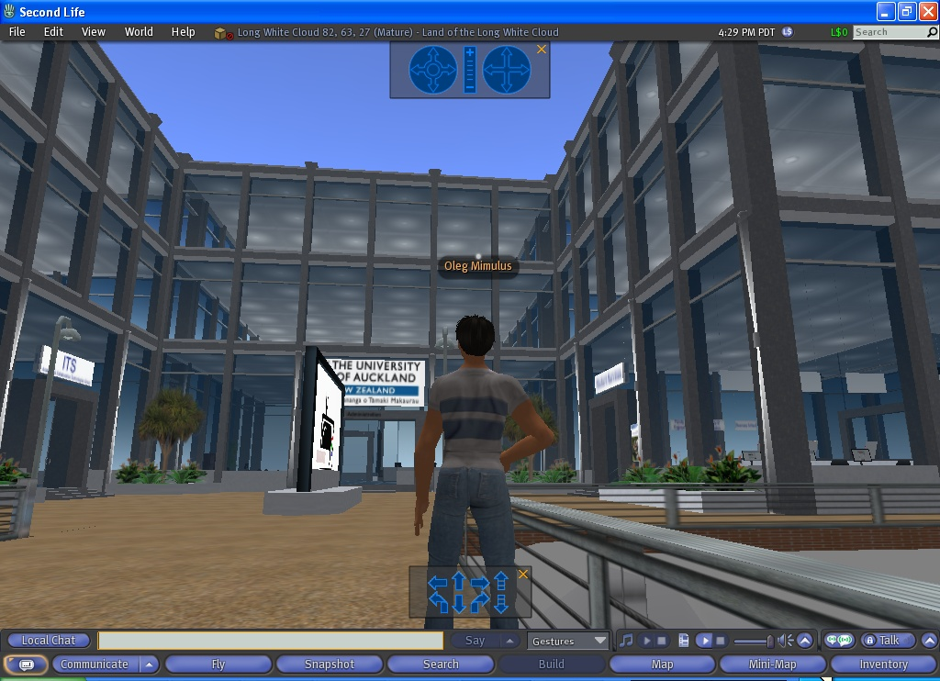
Applications of HCI
SecondLife

Slide 11
Applications of HCI
Kinect, Microsoft

Slide 12
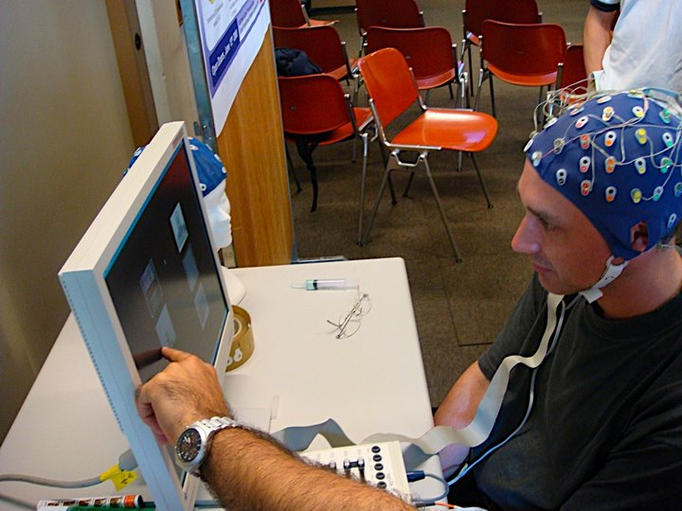
Applications of HCI
BCI at EPFL

Slide 13
Local examples of applying UX Theory
Usability testing
Gestalt spacing
Menu and site hierarchy
User engagements and Visual attractiveness

Slide 14
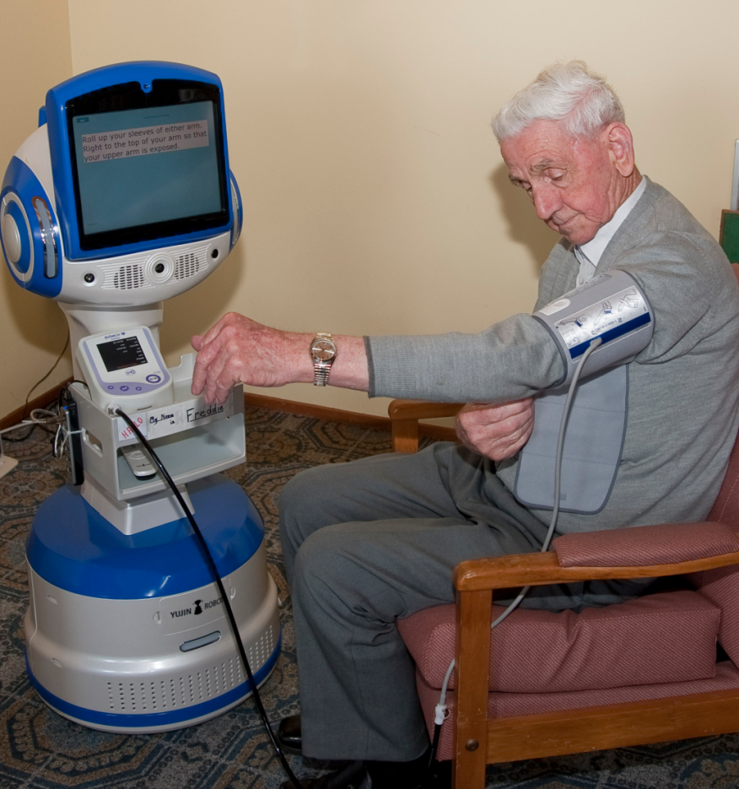
Why Usability Test?
Heath bots welcome screen

Slide 15
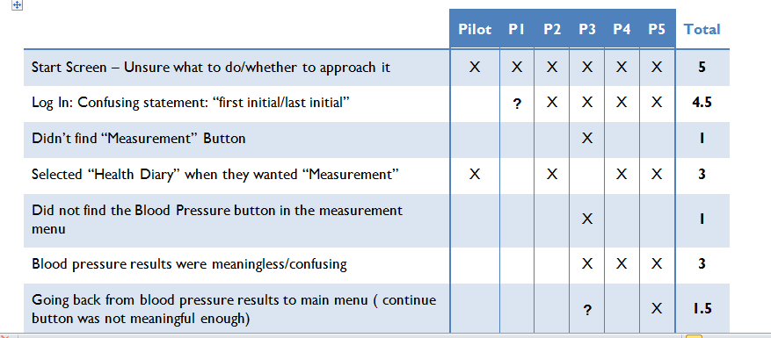
User test Results
Functionally the system is fantastic
But….

Slide 16
Gestalt Spacing
Jobs
People
What does this heading belong to?
Locations
Schedule

Slide 17
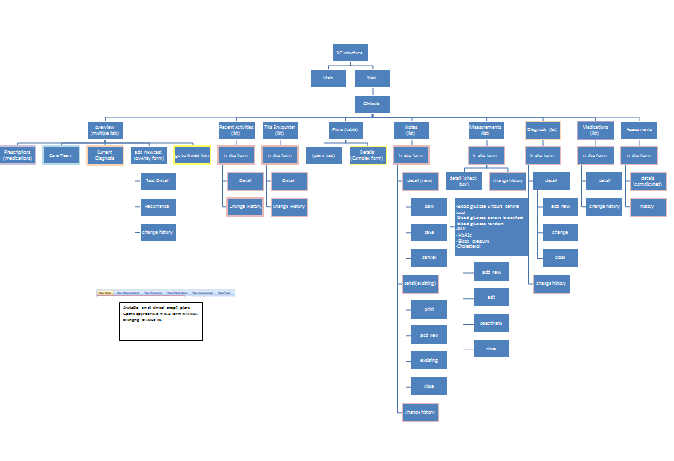
Menu Structure

Slide 18
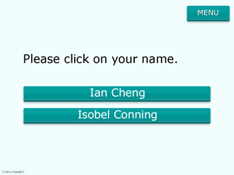
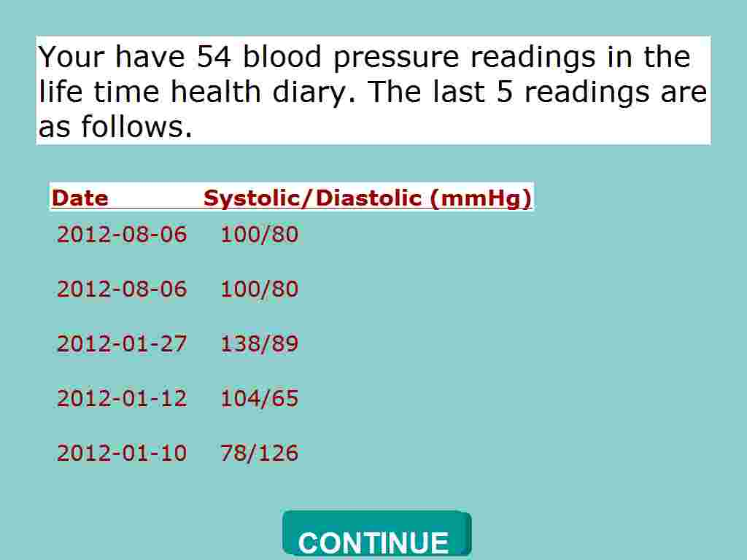
Consistency
Button text
Colours
Shapes
Fonts

Slide 19
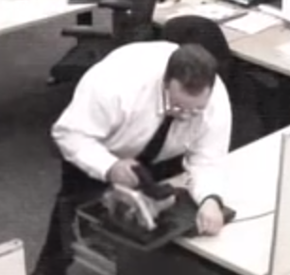
Halftime Entertainment
https://www.youtube.com/watch?v=WXJZXR5Qb-8
Please send your favourite to me for future lectures – video, link, photo…
beryl@cs.auckland.ac.nz

Slide 20
When a UX approach is taken
ALL new students to UoA have to do the Academic integrity online course
Goals
Not too onerous
Engaging
Message clear and all the bases covered
Quite a lot of constraints
Work with Cecil
Under grad and post grad
All faculties & courses
Limited time and budget
Developed by library staff

Slide 21
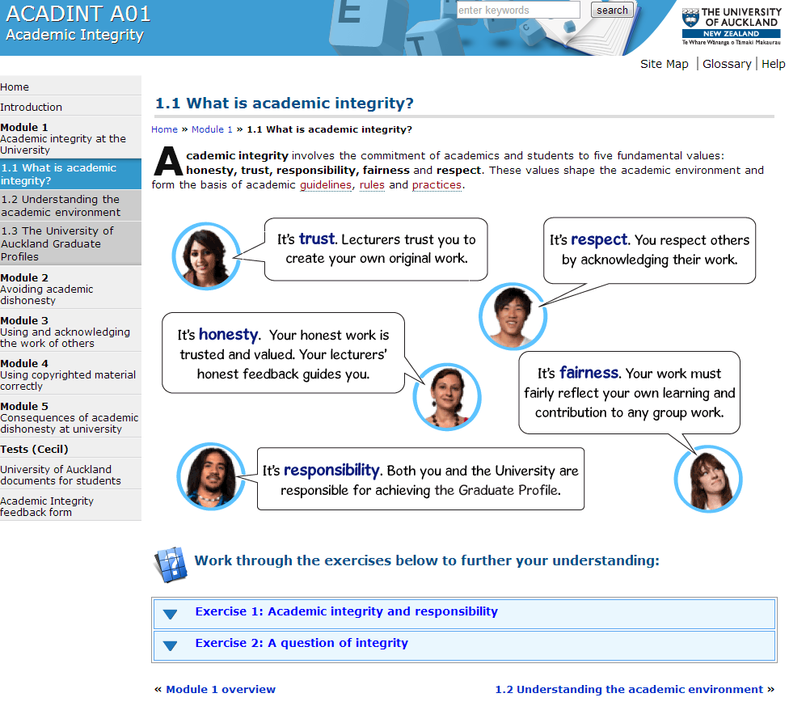
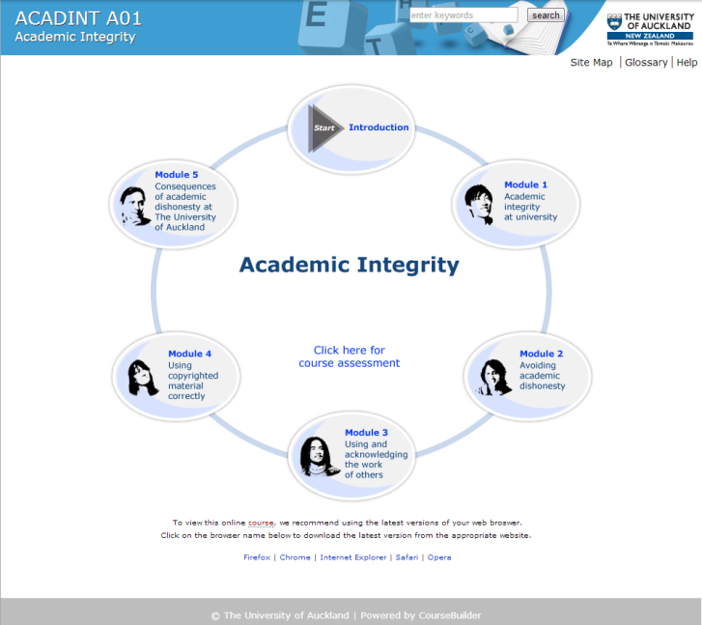
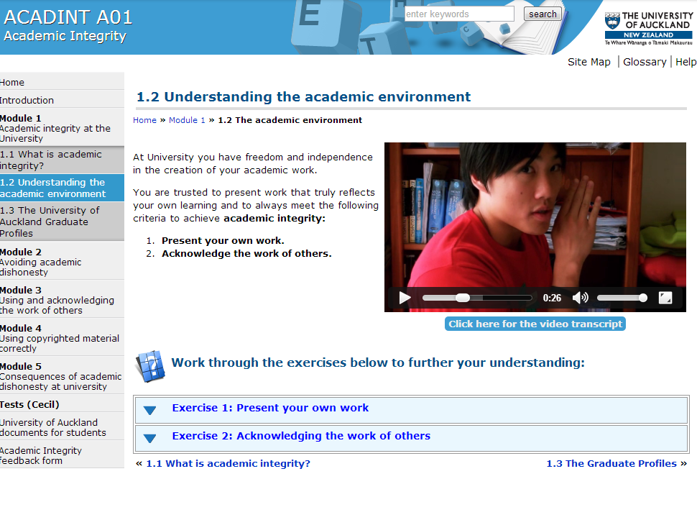
Academic Integrity Course
https://www.academicintegrity.auckland.ac.nz/index.html
Humour
Short sections
Easy navigation

Slide 22
Course Information COMPSCI 345 / SOFTENG 350
All online
Course website for lectures, labs, assignments, contact points, etc
Forums (Computer Science) for student discussions
Cecil for marks, group formation, etc
Dropbox for assignment hand-in
Email to lecturers, tutors, and class or year representative
No required textbook, library has
The Resonant Interface, Steven Heim, 2007
Human-Computer Interaction, by Dix, Finlay,
Abowd & Beale

Slide 23
CS601/602 students
Please email Jim and tell him you are in the course (jim@cs.auckland.ac.nz)
For your literature review you can choose any of the topics advertised here https://www.cs.auckland.ac.nz/courses/compsci345s1c/601_602.html
Direct any questions to Jim

Slide 24
Lecturers
Prof Jim Warren
Course Coordinator
jim@cs.auckland.ac.nz
Ext: 86422
Room Tamaki 723.318
Office hours: by appointment
Research: Health informatics, decision support
Assoc Prof Beryl Plimmer
beryl@cs.auckland.ac.nz
Ext: 82285
Room 303.483
Office hours: 2:30 – 3:30 Tuesday
Research: HCI, Tangible computing

Slide 25
Tutors and Markers
The tutors are PhD students in HCI
Yogi Shastri
ysha962@aucklanduni.ac.nz
Office hours TBA
Moiz Penkar
apen043@aucklanduni.ac.nz
Office hours: TBA
Safurah Abdul Jalil
sabd058@aucklanduni.ac.nz
Office hours: TBA
Markers are five graduate students who excelled in COMPSCI 345
Tutors will manage all interactions with the markers

Slide 26
Assessment
20% Assignments
Assignment 1, 6%, due Sunday 23 March 11:59pm 6%
Assignment 2, 6%, due Sunday 27 April 11:59pm 6%
Assignment 3, 6%, due Sunday 25 May 11:59pm 8%
15% Test
6-7.30pm (rooms TBA), Wednesday 2 April
65% Final Exam
2 hour
A pass in both coursework and the exam is required to pass this paper.
Assignment 2 to be undertaken in groups of 4
Tutorial in week 3 will concentrate on group working skills and group formation
Groups benefit from mixed skills: design; programming; psychology
Assignments 1&3 are individual assignments
Plagiarism is not tolerated at UoA

Slide 27
Assignment 1
Usability Evaluation
In this case of a parking meters (will say more in coming lectures)
A central skill
As part of development team to iteratively guide making the best product
To support decision to purchase or adopt a package for an organisation

Slide 28
Assignment 2
Design
Thinking about the interaction (‘interaction design’)
Fit to the intended user, especially for the most common tasks
Lo-fi (paper) prototyping
The best way to avoid the designing becoming ‘fixed’ too early in the process
And it’s group…

Slide 29
Group Work
Expectations of a BSc/BE graduate (Graduate Profile)
Work collaboratively with others, interacting effectively and demonstrating a respect for other individuals and groups.
Demonstrate a level of literacy, and written and oral communication skills which would enable them to competently undertake functions expected of a science graduate .
Group work can potentially develop the following skills transferable to the workplace:
the ability to listen to others and evaluate different points of view
the development of cooperation and planning skills
the development of leadership and shared leadership skills
the ability to work on large and/or complex projects
the ability to work with individuals from a range of cultures and backgrounds
Assignment contribution will be assessed individually
It’s the way almost all real software development is done

Slide 30
Assignment 3
Prototype
‘Realisation’ of the design
All the ‘small’ decisions that transform a design into software
Choice of controls and how they work, colour, font, icons, etc.
So much can go wrong (or make it so right!)
Also get to practice at web development
Note: although the same problem flows from A2-A3 you do not have to implement what you designed in A2

Slide 31
Lectures
3 lectures per week
Monday 11-12am, Chem (301-G050)
Tuesday 4- 5pm, OGB4 (260.073
Wednesday 5-6pm, PLT1 (303-G20)
Handouts on the course website
At least the day prior to lecture
Best to attend lectures
Lecturers provide examples/anecdotes
Chance to ask questions
Lecture slides are cryptic
Lecturers highlight the important aspects of a topic
In this course previously there was a grade point difference between those who attended class and those who didn’t
Looking at ~3 guest lecturers during the course
If you miss a lecture: get notes; talk to a classmate
Look at lecture recording

Slide 32
Tutorials
You are enrolled in a 1 hour tutorial each week. Six choices available – please attend the correct tutorial, all tutorials are fully subscribed
The tutors will conduct these sessions
Schedule of tutorials is as follows:
Week Topic Tutor
1 No tutorials
2 Usability evaluation Yogi
3 Group working (A2 group formation) Yogi
4 Low fi prototyping Yogi
5 Visual Aesthetics 1 Safurah
Visual Aesthetics 2 Safurah
Break
7 HTML Moiz
8 Styles and CSS Moiz
9 Morae Moiz
10 Assignment 3 clinic Moiz
11 Fitts’ and Hick’s Laws Moiz
12 No tutorials

Slide 33
Information Points
Course website https://www.cs.auckland.ac.nz/courses/compsci345s1c/
Resources section of site
Online textbooks
Interesting websites related to HCI
Tutors during office hours
Class forum
Textbooks in library
Lecturers office hours, by email, phone, by appointment
Computer Science Support Group
UoA support resources
Tuakana for Maori and Pacific students

Slide 34
Class Representative (CS)
There can only be one!
Once elected, attend one AUSA Class Rep Information Session
TBA
Contact classreps@ausa.org.nz, 09 923 7385 or visit Old Choral Hall G15

Slide 35
Questions?
Nao robot

Slide 36
Today’s learning objectives
Meet the lecturers
Be able to define HCI
Be able to articulate the importance of HCI to the success of modern software
Be aware of the course structure and organisation
Appreciate the role of the assessable components in your learning of HCI

