Slide 1
An Evaluation Of Extended Validation and Picture-in-Picture Phishing Attacks
Collin Jackson, Daniel R. Simon, Desney S. Tan, and Adam Barth
Financial Cryptography and Data Security, 2007
Presented by Hui (Henry) Fang

Slide 2
Certificates
1. Normal Certificate
Domain name
2. Extended Validation Certificate
Domain name
Identity of a legitimate business

Slide 3
Homograph Attack
https://www.bankofthevvest.com/
Similar domain names
It may be Https enabled

Slide 4
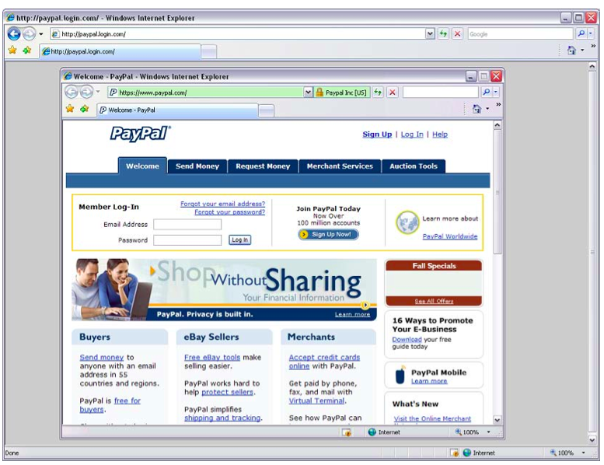
Picture-in-Picture Attack
Mismatched chrome
Focus
Dragging
Maximizing

Slide 5
Experiment Design
Before the task – Familiarization
(Play with two real web sites)
 | Trained Group | Untrained Group | Control Group
Learn security features by reading IE Help | ✔
Can see extended validation security indicator | ✔ | ✔

Slide 6
Experiment Design
During the task – 12 web sites (randomly)
Real site
Real, but confusing, site
Homograph attack
Homograph with warming
Picture-in-Picture attack
Mismatched Picture-in-Picture attack
IP address blocked by phishing filter

Slide 7
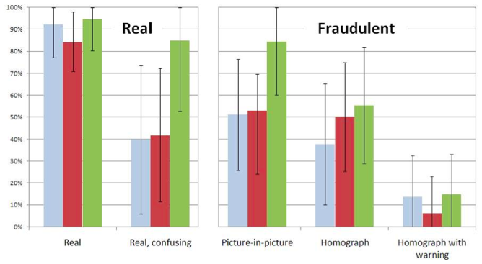
Study Result

Slide 8
Findings
Picture-in-Picture attacks were as effective as homograph attacks
Extended validation did not help users defend against either attack
Extended validation did not help untrained users classify a legitimate site
Training caused more real and fraudulent sites to be classified as legitimate site

Slide 9
Appreciation
Experiment Design: Participants were divided into three groups for comparison.

Slide 10
Criticism
The number of participants was very small – 27 participants only.
The task involved 7 types of websites, and 12 websites were tested. But we don’t know the distribution of those 12 websites.

Slide 11
Question
Does the Picture-in-Picture attack work in mobile browsers ?
What improvements we can make to browsers in order to defend against Picture-in-Picture attack ?

